Slide 1

Large Scale Synthetic
Iris Generation for
Few-Shot Recognition
B.Tech Project Report [Phase-I]
Ashish Yadav (24U020044) | Divyam Agrawal (24U020045)
Supervisor: Dr. Meenakshi Choudhary, Assistant Professor, Dept. of CSE
GitHub: [ Paste GitHub repository link here ]
IIIT Bhopal, November 2026
Notes:
Introduce the project, team and supervisor. Mention that code, notebooks and the report are in the GitHub repository (link on this slide and on the last slide).

Slide 2

Yadav & Agrawal, 2026
Introduction
Iris Recognition
Few-Shot Challenge
Synthetic Data
The iris has highly distinctive texture. A system locates the iris, masks eyelid, eyelash and reflection noise, normalizes the region, then extracts features for matching.
Reflections, occlusion and illumination change between captures. With only a few labelled images per identity, deep models overfit and generalize poorly to unseen images.
Generated samples could add diversity, but must preserve identity. Their usefulness is tested through recognition experiments, not by how realistic they look.
20,000
2,180
1 · 2 · 3 · 5
images, 1,000 subjects
CASIA-Iris-Thousand
images, 218 subjects
IIT Delhi Iris Database
real shots per identity
Few-shot settings tested
Notes:
Iris recognition is accurate but data-hungry. With few images per person, deep models struggle. We ask whether generated iris images can fill that gap. Two datasets: CASIA-Iris-Thousand (20,000 images) and IIT Delhi (2,180 images).

Slide 3

Yadav & Agrawal, 2026
Literature Review
Classical Recognition
Deep and Few-Shot
Wildes, Daugman: iris code, wavelets
Ma et al., Masek: texture filters, pipeline
Limit: segmentation and quality errors
Nguyen et al.: deep iris survey
Lei et al.: MAML few-shot iris
Snell et al.: prototypical networks
Synthetic Generation
Evaluating Synthetic Data
Shah & Ross: statistical texture model
RaSGAN, iWarpGAN: GAN irises
Kordas, Ho: StyleGAN3, diffusion
FID: distribution gap, not identity
Tinsley et al.: identity leakage
Utility: Rank-1 and EER on real data
Research gap: do synthetic irises help recognition when real samples are scarce, and does it hold across datasets?
Notes:
Four strands: classical iris recognition, deep and few-shot learning, synthetic iris generation (statistical models, GANs, diffusion), and evaluation of synthetic data (FID, identity leakage). Gap: measured usefulness of synthetic irises for few-shot recognition, including cross-dataset behaviour.

Slide 4
Yadav & Agrawal, 2026
Problem Statement
01.
Prepare data
Segment, normalize, enhance and quality-filter CASIA and IIT Delhi irises
CENTRAL QUESTION
Can synthetic iris images improve recognition when only a few real samples exist per identity?
02.
Set a baseline
Measure recognition under limited real-sample training
03.
Generate and assess
Create synthetic irises; check quality, diversity, identity consistency
What we test
Synthetic vs real-only training
Synthetic vs conventional augmentation
1, 2, 3 and 5 shots; cross-dataset
Role of quality, quantity and filtering
04.
Compare regimes
Real-only vs conventional augmentation vs synthetic-assisted
05.
Test generalization
Cross-dataset evaluation, ablations and failure analysis
Notes:
The central question and five objectives. The study does not assume synthetic data helps; it tests this against two baselines.

Slide 5
Yadav & Agrawal, 2026
Proposed Methodology
1
Preprocess
2
Few-Shot Sets
3
Baseline
Hough segmentation, eyelid, eyelash and reflection masks, rubber-sheet 64×512, CLAHE, quality score
1/2/3/5-shot sets from quality-filtered images; identity-wise splits with leakage checks
ResNet50, EfficientNet and ViT trained with ArcFace loss on real images, with and without augmentation
4
Identity Latents
5
Generate
6
Verify + Evaluate
β-VAE separates identity from appearance (illumination, pupil, sensor, occlusion)
Conditional diffusion on identity embedding and appearance code; appearance varied
Cosine similarity to real prototypes filters samples; final model tested on CASIA and IIT Delhi
Three regimes compared on identical few-shot splits
Real only
Real + conventional augmentation
Real + verified synthetic
Notes:
Six stages. 1-3 prepare data and a baseline; 4-6 build the generative pipeline and evaluation. Final comparison: real-only vs real + conventional augmentation vs real + verified synthetic, all on the same splits.

Slide 6
Yadav & Agrawal, 2026
System Diagram
1 Datasets
CASIA-Iris-Thousand + IIT Delhi
2 Segmentation
Hough circles; eyelid, eyelash, reflection masks
3 Normalization
Rubber sheet to 64×512 + validity mask
4 Enhance + QA
CLAHE; keep quality score ≥ 50
5 Few-Shot Splits
K = 1, 2, 3, 5; identity-wise, no leakage
10 Evaluation
Rank-1, EER, TAR@FAR, cross-dataset
9 Final Model
real + accepted synthetic; ArcFace loss
8 Identity Filter
cosine similarity to real prototype
7 Diffusion
identity fixed, appearance varied
6 β-VAE
identity + appearance latents
Baseline branch: real-only and real + augmentation models train on the same splits (step 5) and are compared at step 10.
Key algorithms: Circular Hough, Rubber Sheet, CLAHE, ArcFace, β-VAE, Conditional DDPM, Cosine verification.
Notes:
Top row left-to-right is data preparation; bottom row right-to-left is generation, verification, the final model and evaluation. Only identity-verified synthetic samples are used for training.

Slide 7
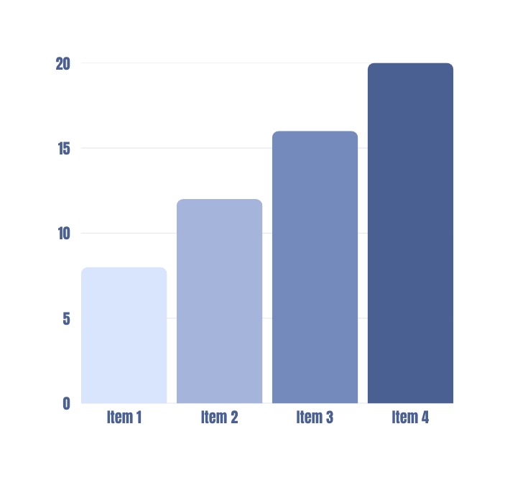
Yadav & Agrawal, 2026
Implementation
20
94,005
1,261
1.34%
Jupyter notebooks
synthetic images
passed identity check
acceptance rate
Stage | Notebooks | What was done
Preprocessing | 01–06 | Segmentation, normalization, CLAHE, quality score, splits
Baseline | 07 | ResNet50 / EfficientNet / ViT with ArcFace loss
Synthesis | 08–12 | β-VAE, diffusion, identity filter, FID / KID / LPIPS
Recognition | 13–14 | ViT, Swin, ConvNeXt on real + accepted synthetic
Analysis | 15–20 | Grad-CAM, ablations, statistics, inference demo
Tech stack
Python, Jupyter, PyTorch, OpenCV, NumPy, Pandas, scikit-learn, Matplotlib, Seaborn
Key settings
Normalized iris 64×512
CLAHE 8×8 grid, clip 2.0
Quality threshold 50 / 100
256-d embeddings
ArcFace, Triplet, Center losses
Notes:
Everything is implemented as 20 modular notebooks, from data exploration to inference demo. The generator produced 94,005 images, but only 1,261 (1.34%) passed identity verification against real identity prototypes.

Slide 8
Yadav & Agrawal, 2026
Results and Analysis
EER (%) | CASIA-Iris-Thousand |  |  | IIT Delhi (cross)
 | Real | Aug. | Synth | Real | Aug. | Synth
1-shot | 20.75 | 19.56 | 20.64 | 27.54 | 27.42 | 26.14
2-shot | 11.96 | 8.59 | 11.96 | 20.87 | 19.17 | 18.02
3-shot | 7.07 | 5.60 | 7.64 | 17.65 | 16.15 | 14.75
5-shot | 3.65 | 2.93 | 3.95 | 14.66 | 12.74 | 20.45
Augmentation: best CASIA Rank-1 and EER at all shots; best cross-dataset Rank-1
Synthetic beat real-only Rank-1 at 1–2 shot (CASIA); lowest cross-dataset EER at 1–3 shot
5-shot cross-dataset: synthetic fell to 55.00% Rank-1
Only 1.34% accepted; FID 144.6–205.3 vs 19.7–33.6 (real)
Bold = lowest EER in each group (lower is better)
Notes:
Be upfront: synthetic-assisted training did not beat conventional augmentation overall. On CASIA it improved Rank-1 over real-only at 1- and 2-shot only. Cross-dataset it had the lowest EER at 1-3 shots but a weak 5-shot result. Caveats: single training seed; sampler not fully matched between baseline and final model.

Slide 9
Yadav & Agrawal, 2026
Conclusion & Future Work
Conclusion
Future Work
20-notebook pipeline built; 94,005 synthetic irises generated
Only 1.34% passed identity verification; FID shows a clear gap to real images
Conventional augmentation was strongest and most consistent overall
Synthetic data helped in places (CASIA 1–2 shot Rank-1; cross-dataset EER at 1–3 shots), not consistently
Limits: one seed per configuration; sampler not fully matched
01
Improve fidelity: sharpness was 3.0–3.7× real
02
Better identity preservation; revisit the 1.34% acceptance criteria
03
Multi-seed runs with matched training protocols
04
More datasets for cross-dataset generalization
05
Diversity and memorization checks, then scale up
Notes:
Synthetic iris generation remains promising, but the current pipeline does not yet beat conventional augmentation. Priorities: fidelity, identity preservation, sample selection, and more rigorous experiments.

Slide 10
Yadav & Agrawal, 2026
References
[1] J. Daugman, “High confidence visual recognition of persons…,” IEEE TPAMI, 1993.
[2] K. Nguyen, H. Proença, F. Alonso-Fernandez, “Deep learning for iris recognition: A survey,” ACM CSUR, 2024.
[3] S. Lei et al., “Iris recognition based on few-shot learning,” Comput. Animat. Virtual Worlds, 2021.
[4] A. Kordas et al., “Synthetic iris images: Cartesian vs polar representation,” Sensors, 2024.
[5] R. P. Wildes, “Iris recognition: An emerging biometric technology,” Proc. IEEE, 1997.
[6] L. Ma, T. Tan, Y. Wang, D. Zhang, “Personal identification based on iris texture analysis,” TPAMI, 2003.
[8] A. Kumar, A. Passi, “Comparison and combination of iris matchers,” Pattern Recognition, 2010.
[9] J. Snell, K. Swersky, R. Zemel, “Prototypical networks for few-shot learning,” NeurIPS, 2017.
[12] S. Shah, A. Ross, “Generating synthetic irises by feature agglomeration,” ICIP, 2006.
[14] S. Yadav, C. Chen, A. Ross, “Synthesizing iris images using RaSGAN,” CVPRW, 2019.
[15] S. Yadav, A. Ross, “iWarpGAN: Disentangling identity and style,” IJCB, 2023.
[17] J. Ho, A. Jain, P. Abbeel, “Denoising diffusion probabilistic models,” NeurIPS, 2020.
[18] P. Tinsley, A. Czajka, P. Flynn, “Assessing identity leakage in synthetic irises,” arXiv:2211.05629, 2022.
[19] M. Heusel et al., “GANs trained by a two time-scale update rule” (FID), NeurIPS, 2017.
[23] D. P. Kingma, M. Welling, “Auto-encoding variational Bayes,” ICLR, 2014.
[24] J. Deng et al., “ArcFace: Additive angular margin loss for deep face recognition,” CVPR, 2019.
Numbering follows the project report.
Project Repository
Code, notebooks, report, results
[ Paste GitHub repository link here ]
Notes:
Thank the audience. The GitHub repository contains the code, notebooks, report and results.

